Slide 1
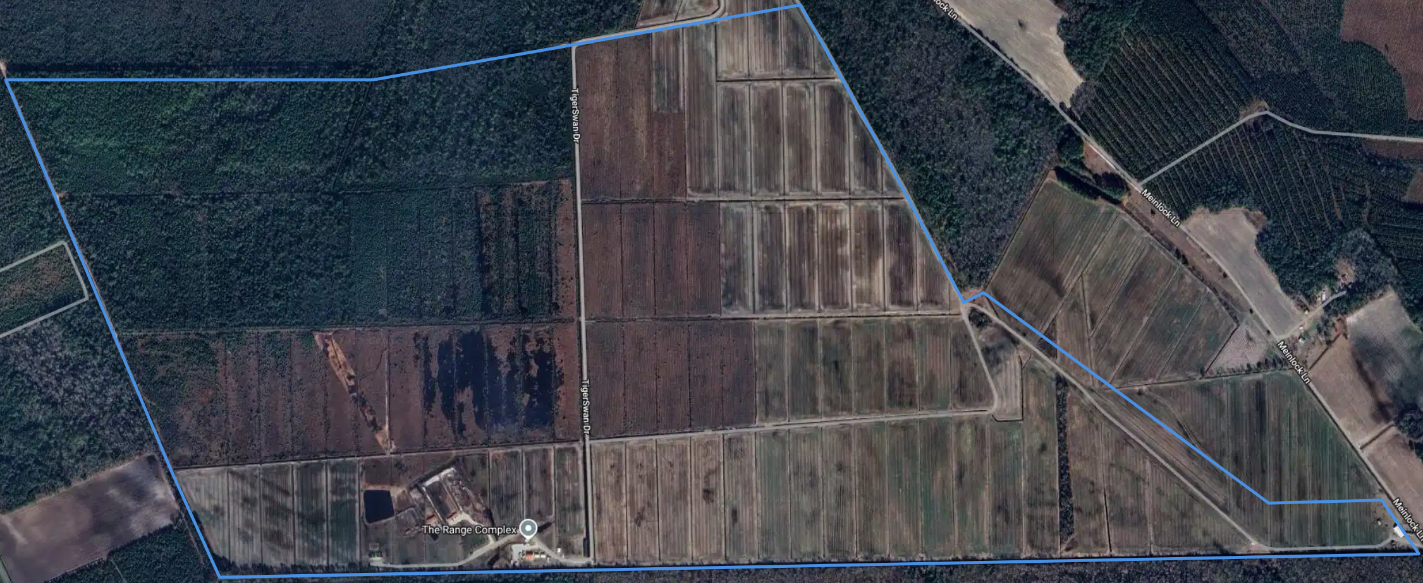
Airspace – Public Release
17S QU 11313 69371
17S QU 10211 69152
17S QU 09263 69131
17S QU 09715 68129
17S QU 09845 67862
17S QU 12944 67994
17S QU 12843 68129
17S QU 12551 68116
17S QU 11802 68641
17S QU 11751 68613
17S QU 11536 68995
Notes:
Public Release

Slide 2
Airspace Overview – Public Release
2150 Meters / 7053 feet
3800 Meters / 12467 feet
1300 Meters / 4265 feet
3000 Meters / 9842 feet
Notes:
Public Release

Slide 3
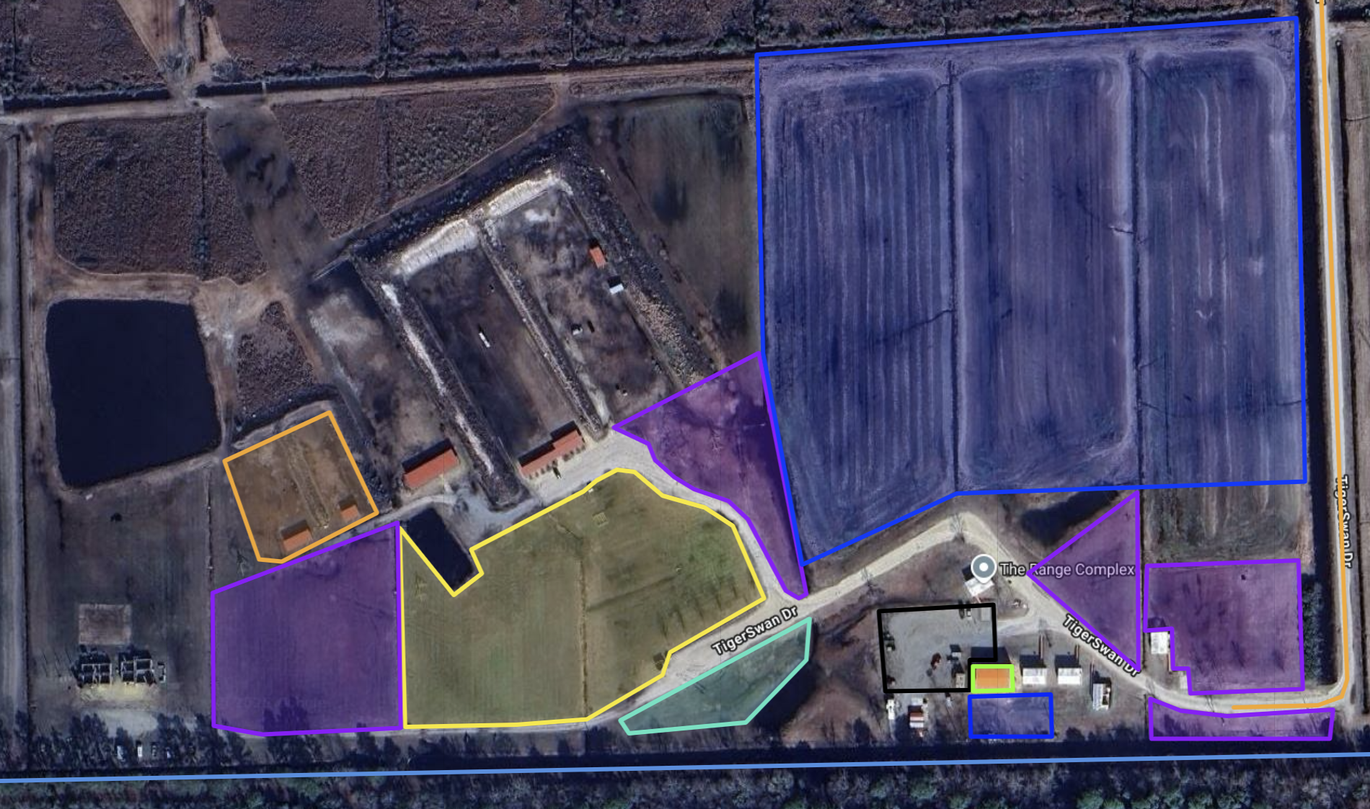
Designated Areas – Public Release
Public Parking
DV Parking
Food Trucks & Vendors
Pay to play w/ prizes
Designated flight areas
Build & Fly
The Armory
The Armory will be for anyone who needs to repair and or modify their UAS to complete the courses.
-Testing, Pre & Post flight conducted out back
Notes:
Public Release

Slide 4
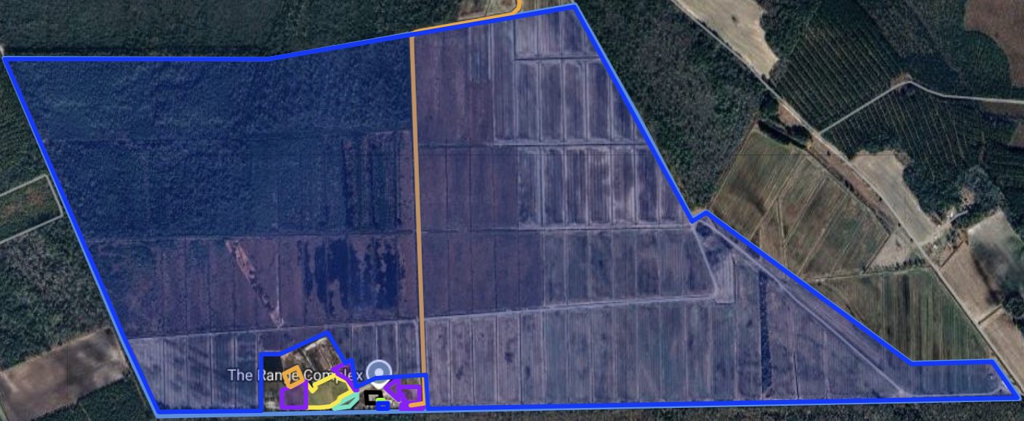
Vendor Only Airspace
Only when competition is done for the day.
Airspace Dimensions
17S QU 10558 67983
17S QU 10537 68081
17S QU 10513 68068
17S QU 10449 68176
17S QU 10278 68094
17S QU 10211 68093
17S QU 10216 67890
17S QU 09850 67875
17S QU 09721 68135
17S QU 09268 69128
17S QU 10213 69148
17S QU 11307 69364
17S QU 11749 68604
17S QU 11801 68635
17S QU 12550 68109
17S QU 12840 68124
17S QU 12932 67999
17S QU 10815 67909
17S QU 10807 68030
17S QU 10627 68017
Notes:
Public Release

Slide 5
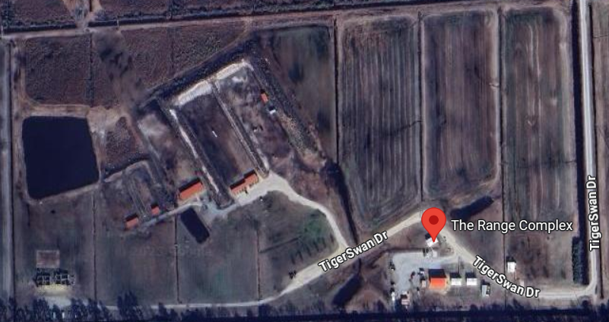
FLIGHT
DEMO
PARKING
Briefing
Latrine
OPS MEDIC
Vendors
Registration
EXTRA PARKING
TENTS
DV PARKING
Food Truck
PARKING
Notes:
Public Release

Slide 6
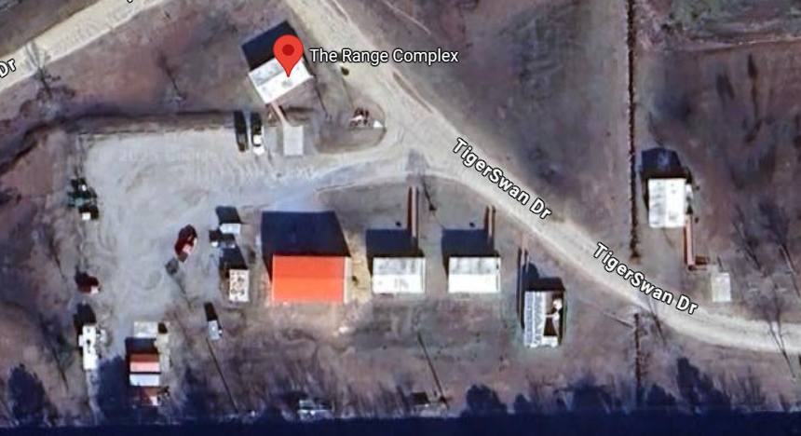
OVERFLOW PARKING
MEETING / INDOOR DEMO
DV PARKING
ARMORY / FAB SHOP
TEAM
LATRINE
Notes:
Public Release

Slide 7
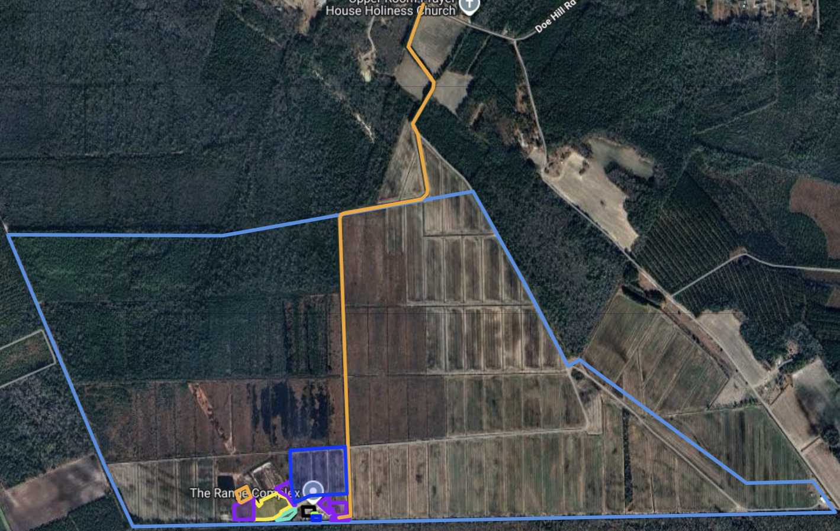
Main Travel Road
Main Travel Road
Notes:
Public Release

Slide 8
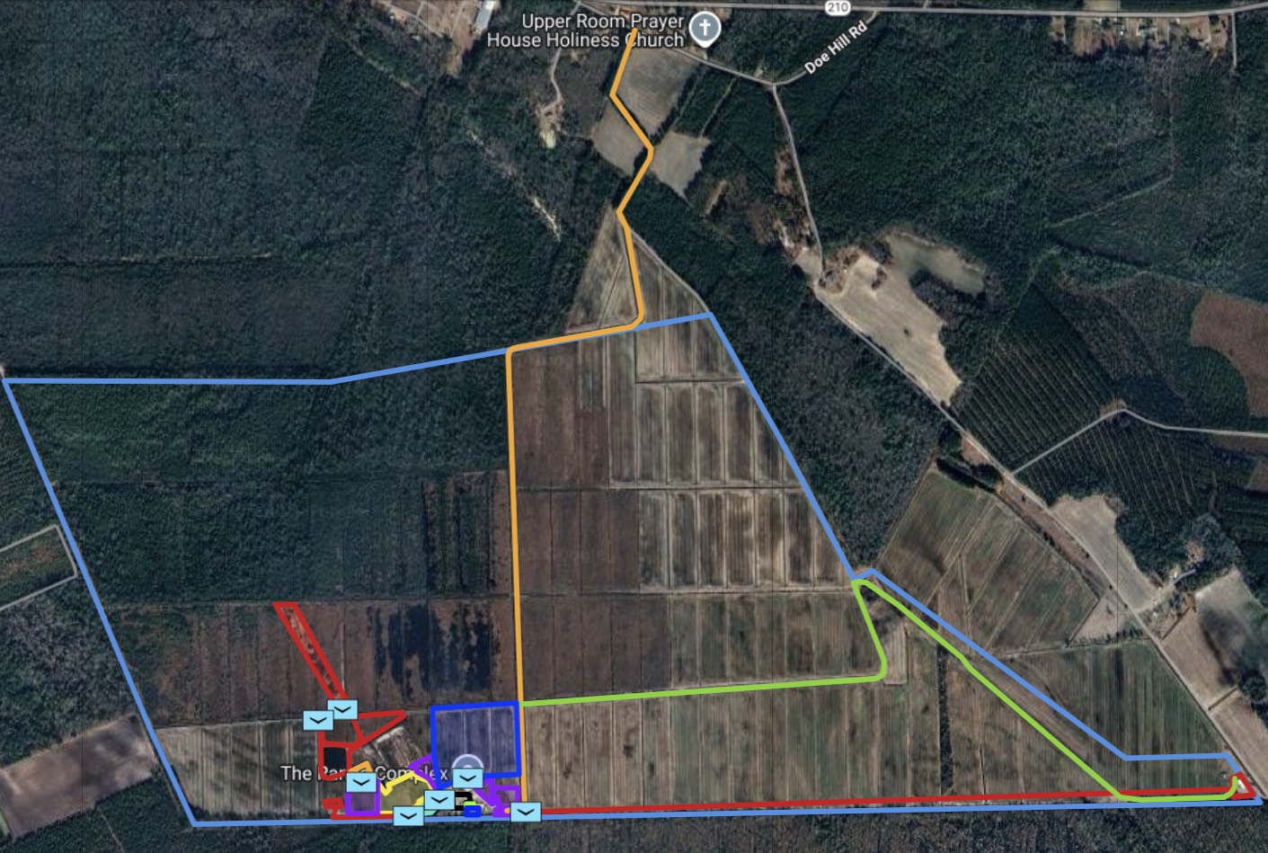
Range Overview – Day 1 – Public Release
Obstacles (Lane 4)
Driving Lane (Lane 1)
Facility (Lane 2)
Shoot House (Lane 3)
Notes:
Public Release

Slide 9
Day 1 Lanes – Public Release
4 Total Lanes.
Maximum of 10 Minutes to complete each lane.
Furthest distance to fly (Longest Lane) – 2,100 meters / 6,890 feet.
Three lanes (1 to 3) will be active at the same time. (1 FPV/Quad per lane)
Lane four will be a traditional style FPV race. (5 FPVs/Quad each race)
You will need to have the ability to fly through obstacles.
Could have issues flying in and around structures of various materials.
Will need to find targets.
Use of autonomous features is unauthorized. (GPS is authorized)
Quadcopters only – Recommeneded sizes 3 inch up to 10 inch. Bring multiple sizes.
NO PROP GUARDS
Arrive No Later Than 0800 (8AM)
Event Start Time: 0900 (9AM)
Event Stop Time: 1600 (4PM)
Notes:
Public Release

Slide 10
Day 2 Lanes – Public Release
Team Size: 9
Top competitors will be team captains.
Have the ability to drop munitions.
Have the ability for one way attack.
Use of autonomous features is unauthorized. (GPS is authorized)
The Armory can be utilized to modify aircraft on site.
Quadcopters and Fixed wings are authorized.
Arrive No Later Than 0800 (8AM)
Event Start Time: 0900 (9AM)
Event Stop Time: 1600 (4PM)
Notes:
Public Release

Slide 11
Square Obstacle Dimensions – Public Release
4 Feet / 48 inches
2.5 Feet / 29 inches
2.5 Feet / 29 inches
4 Feet / 48 inches
2x2.5
2x2.5
4 Feet / 48 inches
4x4
2 Feet / 24 inches
8 Feet / 96 inches
4x4
12 Feet / 144 inches
NO PROP GUARDS ALLOWED
10 Minutes to Complete
Unknown Obstacles
Notes:
Public Release

Slide 12
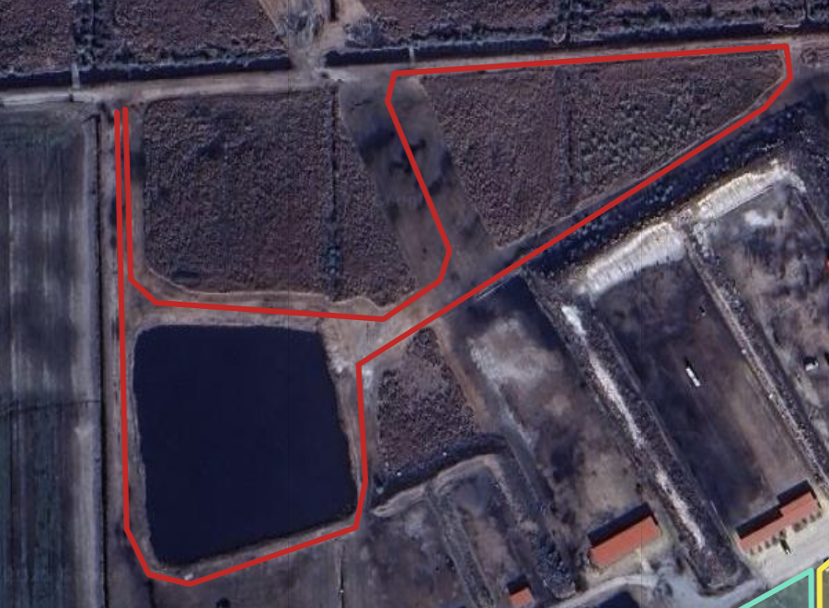
Driving Lane (Lane 1) – Public Release
Start & Stop
NO PROP GUARDS ALLOWED
Red Line = Vehicle Lane
10 Minutes to Complete
Red Route is 2,932 feet
Unknown Obstacles
Drive Lane
17S QU 10205 68170
17S QU 10212 68023
17S QU 10220 68007
17S QU 10235 68004
17S QU 10293 68025
17S QU 10296 68042
17S QU 10293 68083
17S QU 10435 68177
17S QU 10444 68188
17S QU 10442 68199
17S QU 10303 68186
17S QU 10301 68176
17S QU 10324 68124
17S QU 10321 68113
17S QU 10301 68099
17S QU 10220 68103
17S QU 10211 68111
17S QU 10208 68171
Notes:
Public Release

Slide 13
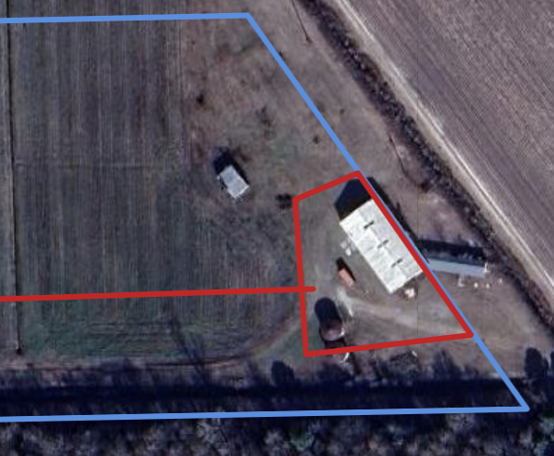
Facility (Lane 2) – Public Release
Start & Stop
Task
Fly to area.
Finding items.
Return to finish.
Time
10 Minutes to Complete
Maximum Range
2,100 meters
Notes:
Public Release

Slide 14
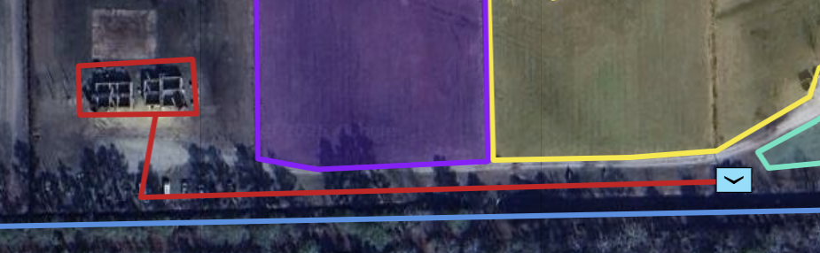
Shoot House (Lane 3) – Public Release
Start & Stop
Task
Fly to area.
Finding items.
Return to finish.
Time
10 Minutes to Complete
Maximum Range
250 meters
Notes:
Public Release

Slide 15
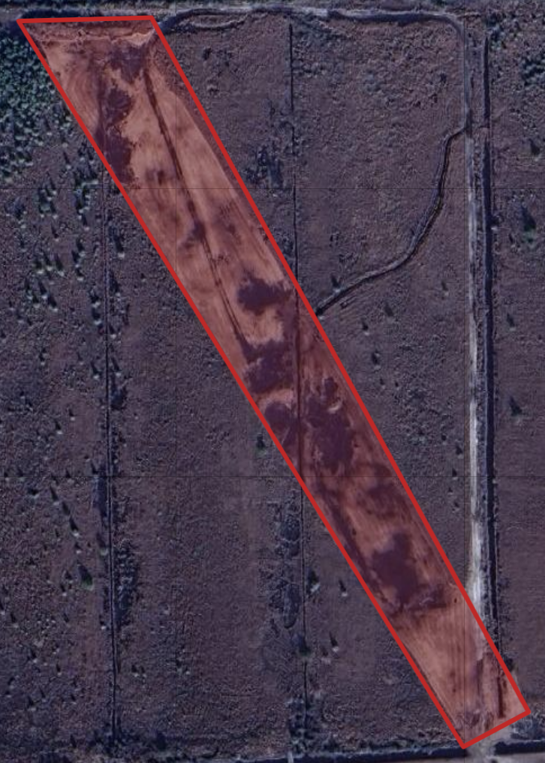
Obstacles (Lane 4) – Public Release
Task
Fly Though Obstacles.
Fly through final gate to finish.
Time
10 Minutes to Complete
Maximum Range
1,100 meters
14 Obstacles
NO PROP GUARDS
Start & Stop
Notes:
Public Release

Slide 16
Square Obstacle Dimensions – Public Release
4 Feet / 48 inches
4 Feet / 48 inches
4 Feet / 48 inches
4 Feet / 48 inches
12 Feet / 144 inches
16 Feet / 192 inches
NO PROP GUARDS ALLOWED
4 Feet / 48 inches
10 Minutes to Complete
4 Feet / 48 inches
Unknown Obstacles
10 Feet / 120 inches
5 Feet / 60 inches
Notes:
Public Release

Slide 17
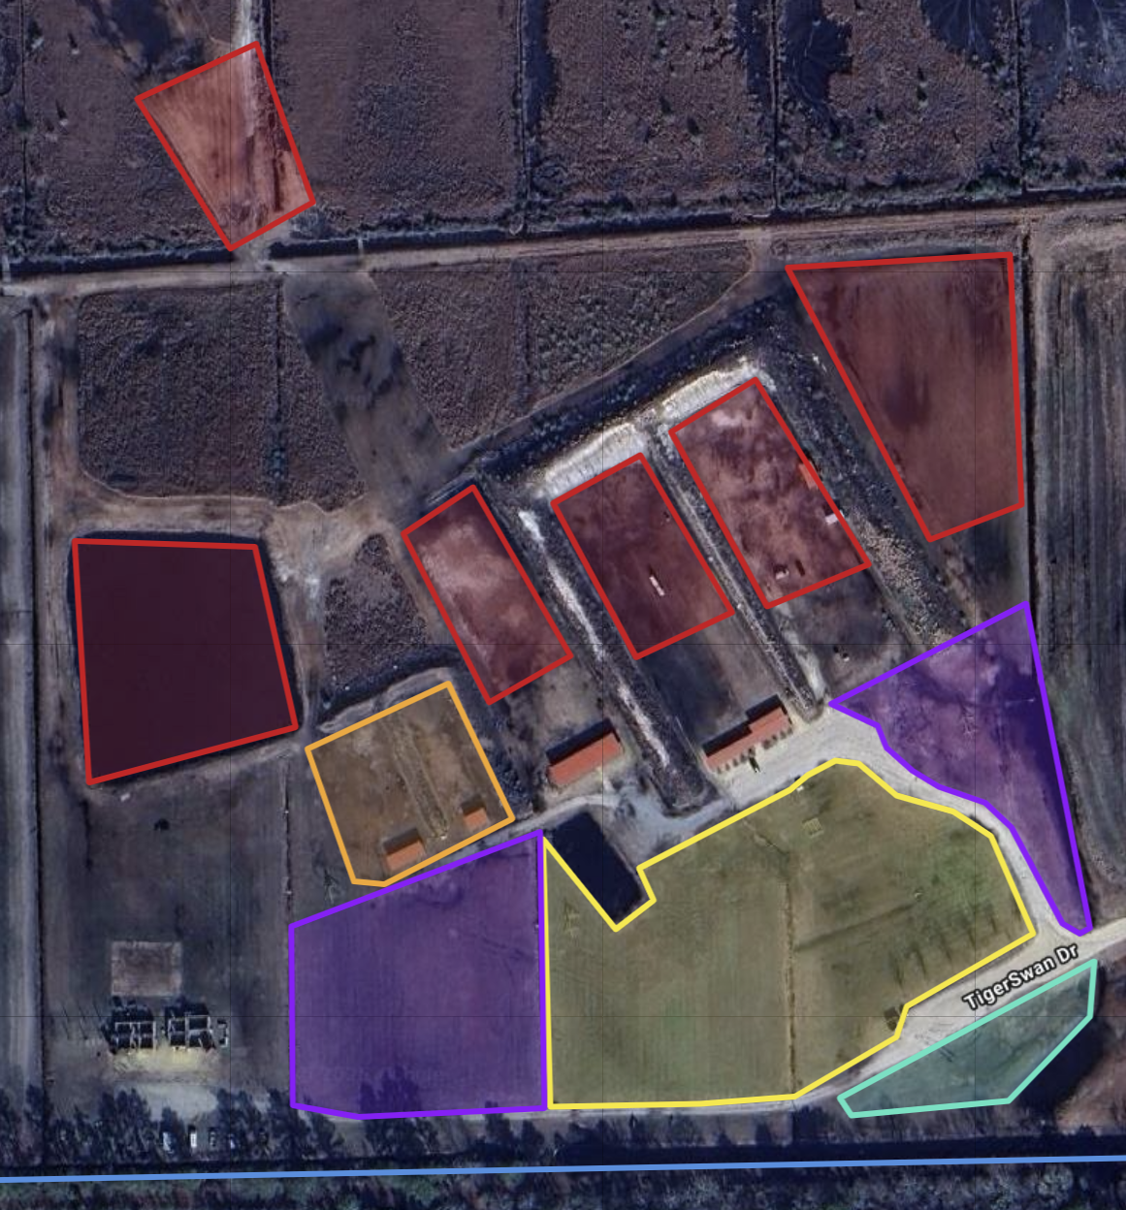
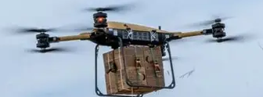
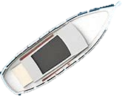
Range Overview – Day 2 – Public Release
Target Areas
4
3
2
1
Notes:
Public Release

Slide 18
Bomb Drops – Public Release
6 Feet
3 Feet
Car
3 Feet
6 Feet
Red = x Points
Yellow = x points
Green = x Points
Anything else = 0 Points
Notes:
Public Release

Slide 19
One Way Attack Target – Public Release
20 inch x 20 inch
14 inch x 16 inch
8 inch x 24 inch
14 inch x 16 inch
20 inch x 20 inch
Red = x Points
Yellow = x points
Green = x Points
Anything else = 0 Points
Notes:
Public Release

Slide 20
Square Obstacle Dimensions – Pay to play – Public Release
4 Feet / 48 inches
10 inch
X
10 inch
28 inch
X
10 inch
10 inch
X
10 inch
NO PROP GUARDS ALLOWED
10 Minutes to Complete
Unknown Obstacles
28 inch
X
10 inch
28 inch
X
28 inch
28 inch
X
10 inch
4 Feet / 48 inches
10 inch
X
10 inch
28 inch
X
10 inch
10 inch
X
10 inch
Notes:
Public Release

